Slide 1
Management Products and Dealing
Narongrit Sridonthong 5710210119
Wanchai Nupinit 5710210389

Slide 2
App Specifications
Save products information, Sale Information ,billing Information to database.
Show products information, Sale Information, billing Information from database.
Add , Update , Delete , Product information.
Connect database with MySQL
Graphic User Interface (GUI)
Calculate total amount and change of sale
Print billing to file

Slide 3
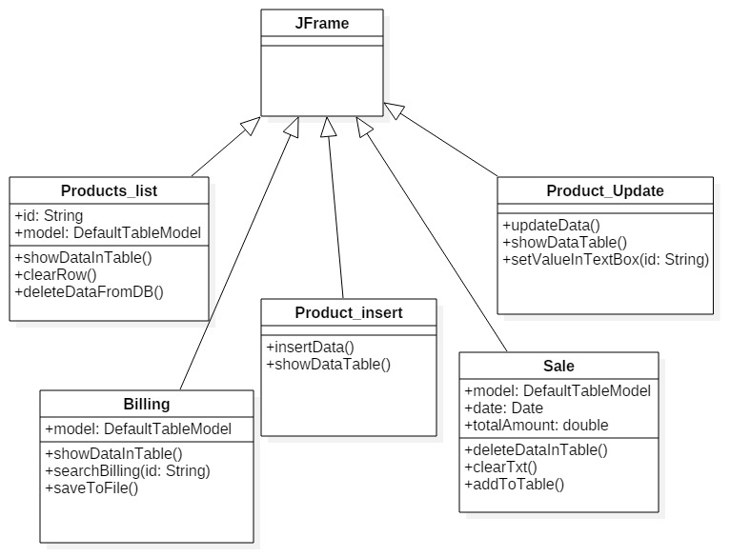
Class Diagrams

Slide 4
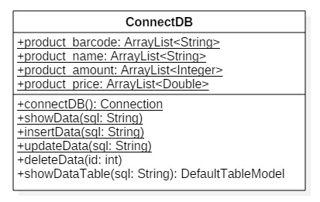
Class Diagrams

